Slide 1
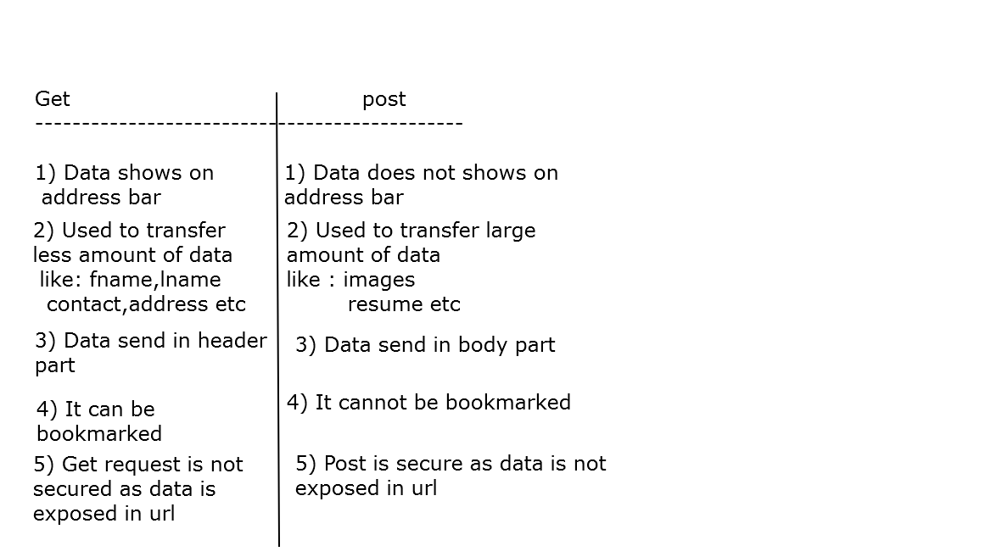

Slide 2
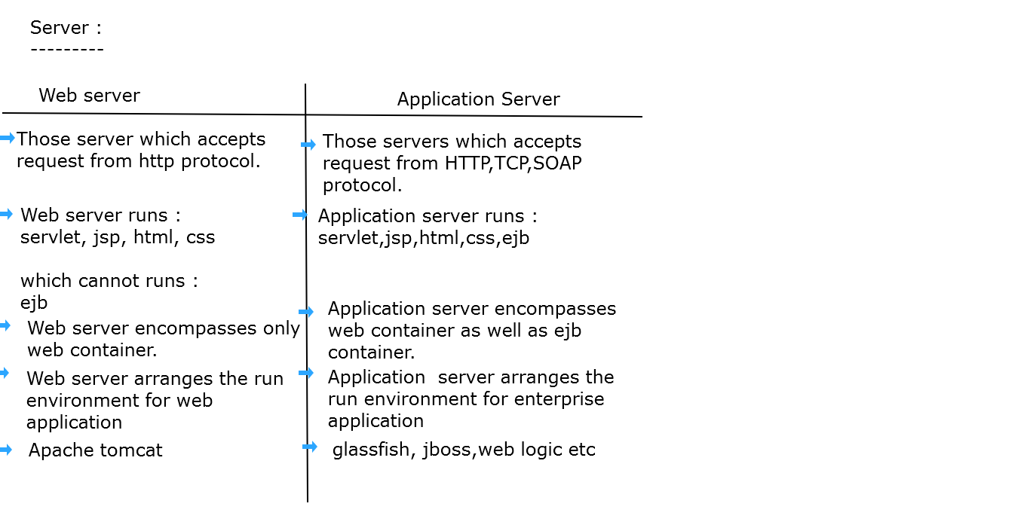

Slide 3
Layers in Application
Three layers involved in the application namely :
Presentation Layer
Business Layer (Application Layer)
Data Layer.

Slide 4
Presentation Layer (To view the application)
It is also known as Client layer.
Top most layer of an application.
This is the layer we see when we use a software.
By using this layer we can access the webpages.
The main functionality of this layer is to communicate with Application layer.
This layer passes the information which is given by the user in terms of keyboard actions, mouse clicks to the Application Layer.
For example, login page of Gmail where an end user could see text boxes and buttons to enter user id, password and to click on sign-in.

Slide 5
Business Layer (To perform operations on the application)
It is also known as Application Layer which is also known as logical layer.
As per the gmail login page example, once user clicks on the login button, Application layer interacts with Database layer and sends required information to the Presentation layer.
It controls an application’s functionality by performing detailed processing.
This layer acts as a mediator between the Presentation and the Database layer.
Complete business logic will be written in this layer.

Slide 6
Data Layer (To share and retrieve the data)
The data is stored in this layer.
Application layer communicates with Database layer to retrieve the data.
It contains methods that connects the database and performs required action e.g.: insert, update, delete etc.

Slide 7
Software Architecture
Software architecture refers to the fundamental structures of a software system and the discipline of creating such structures and systems.
Software Architecture consists of One Tier, Two Tier, Three Tier and N-Tier architectures.
A “tier” can also be referred to as a “layer”.

Slide 8
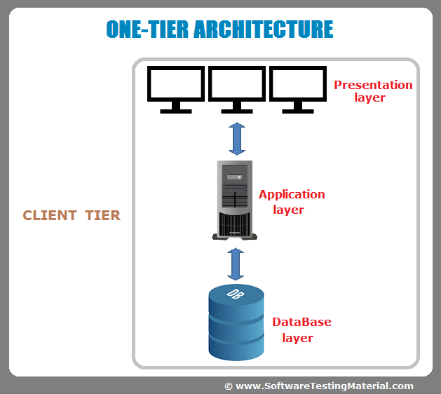
1 Tier Architecture (Also known as Standalone application)

Slide 9
1 Tier Architecture
One tier architecture has all the layers such as Presentation, Business, Data Access layers in a single software package.
Applications which handles all the three tiers such as MP3 player, MS Office are come under one tier application.
The data is stored in the local system or a shared drive.
Any time you install a DB in your system and access it to practice SQL Queries it is 1 Tier Architecture. But such architecture is rarely used in production.

Slide 10
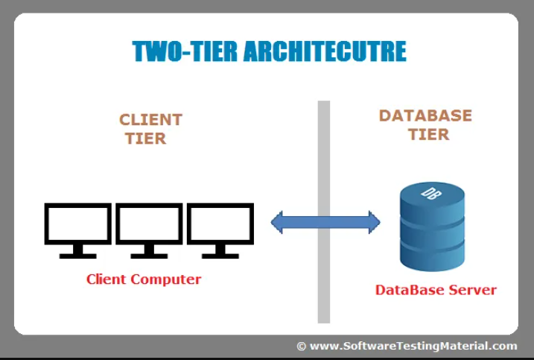
2 Tier Architecture (Also known as Client-Server application)

Slide 11
2 Tier Architecture
The Two-tier architecture is divided into two parts:
1. Client Application (Client Tier) 2. Database (Data Tier)
Client system handles both Presentation and Application layers and Server system handles Database layer.
It is also known as client server application. The communication takes place between the Client and the Server.
Client system sends the request to the Server system and the Server system processes the request and sends back the data to the Client System
Example : Contact management system created using MS-Access.
Client server mechanism within any organization, where we cannot use server from outside, it can only be accessible within that organization.

Slide 12
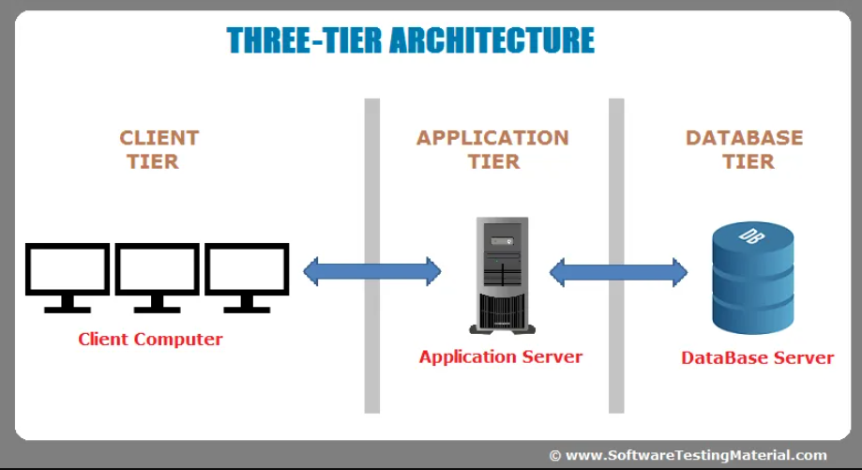
3 Tier Architecture ( Also known as Web Based application)

Slide 13
3 Tier Architecture
The Three-tier architecture is divided into three parts:
1. Presentation layer (Client Tier) 2. Application layer (Business Tier) 2. Database layer (Data Tier)
Client system handles Presentation layer, Application server handles Application layer and Server system handles Database layer.
Example : Any large website on the internet including any tutorial site or any organization site.

Slide 14
N Tier Architecture
Another layer is N-Tier application.
N-Tier application also known as Distributed application.
It is similar to three tier architecture but different business logics for different clients.
Example : MakeMyTrip.com
Amazon.com etc

Slide 15
Common Gateway Interface (CGI)
The Common Gateway Interface (CGI) is a standard for writing programs that can interact through a Web server.
These programs allow a Web developer to deliver dynamic information or content (usually in the form of HTML) via the browser to the user.
A CGI program can be written in any language, including Java, that can be executed by your Web server.
Here CGI Script(inside CGI webserver) are written in the native languages such as C, C++, Perl.

Slide 16
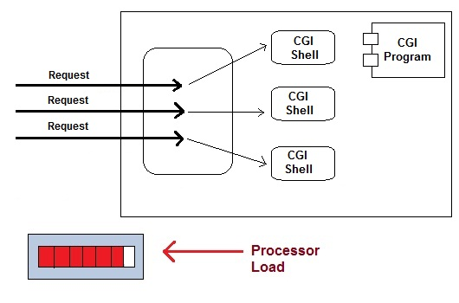
CGI (Common Gateway Interface)

Slide 17
Disadvantages of CGI
For each request CGI Server receives, It creates new Operating System Process.
If the number of requests from the client increases then more time it will take to respond to the request.
Here CGI Script are written in the native languages such as C, C++, Perl, which increases the chances of platform dependency.
Makes system slow
Processing time more
Response time is high

Slide 18
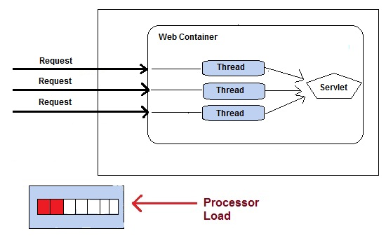
Servlet
A servlet is a java technology-based web component, managed by a container called servlet container or servlet engine or web container, that generates dynamic content.
It is a technology to create web application in java, it is not a language.

Slide 19
Advantages
Less response time because each request runs in a separate thread.
Servlets are object oriented.
Servlets are platform independent.
Here the concept of threads are used, which are light weight process.

Slide 20
Servlet API
Servlet API consists of two important packages that encapsulates all the important classes and interface, namely :
javax.servlet
javax.servlet.http
Some Important Classes and Interfaces of javax.servlet
CLASSES | INTERFACES
GenericServlet | Servlet
ServletException | ServletContext ServletConfig
ServletInputStream | ServletRequest ServletResponse
ServletOutputStream | Filter, FilterConfig, FilterChain

Slide 21
Some Important Classes and Interfaces of javax.servlet.http
CLASSES | INTERFACE
HttpServlet | HttpServletRequest
Cookie | HttpServletResponse
HttpServletRequestWrapper HttpServletResponseWrapper | HttpSession

Slide 22
Life Cycle of servlet
Step 1 : Loading Servlet Class : A Servlet class is loaded when first request for the servlet is received by the Web Container.
Step 2 : Servlet instance creation : After the Servlet class is loaded, Web Container creates the instance of it. Servlet instance is created only once in the life cycle.
Step 3 : Call to the init() method : init() method is called by the Web Container on servlet instance to initialize the servlet.
Signature of init() method :
public void init(ServletConfig config) throws ServletException

Slide 23
Step 4 : Call to the service() method : The containers call the service() method each time the request for servlet is received. The service() method will then call the doGet() or doPost() method based on the type of the HTTP request.
Signature of service() method :
public void service(ServletRequest request, ServletResponse response) throws ServletException, IOException
Step 5 : Call to destroy() method: The Web Container call the destroy() method before removing servlet instance, giving it a chance for cleanup activity.

Slide 24
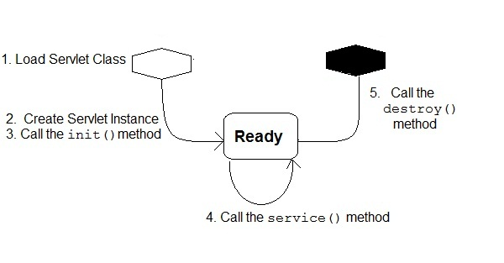
Life Cycle of Servlet

Slide 25
How a Servlet Application works
Web container is responsible for managing execution of servlets and JSP pages for Java EE application.
When a request comes in for a servlet, the server sends the request to the Web Container. Web Container is responsible for instantiating the servlet or creating a new thread to handle the request.The container creates multiple threads to process multiple requests to a single servlet.
Servlets don't have a main() method. Web Container manages the life cycle of a Servlet instance.

Slide 26
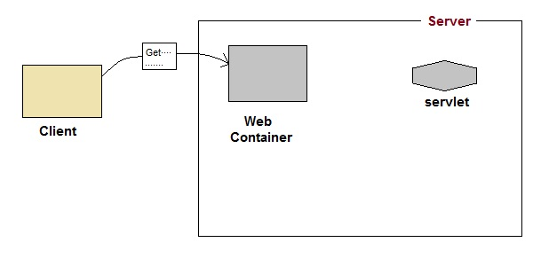
How a Servlet works
User sends request for a servlet.

Slide 27
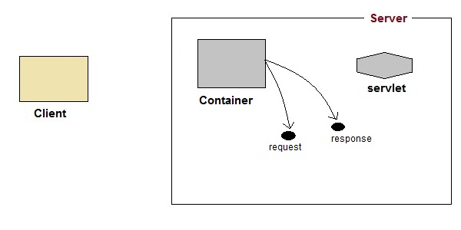
The container finds the servlet using deployment descriptor
and creates two objects :
HttpServletRequest
HttpServletResponse

Slide 28
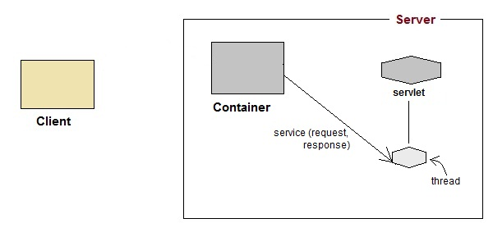
Then the container creates or allocates a thread for that request and calls the Servlet's service() method and passes the request, response objects as arguments.

Slide 29
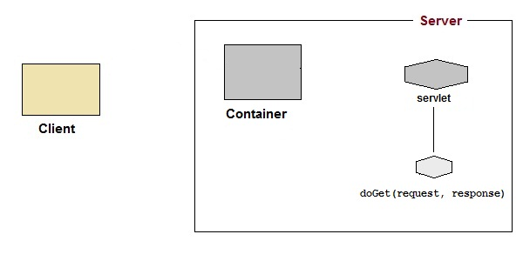
The service() method, then decides which servlet method, doGet() or doPost() to call, based on HTTP Request Method(Get, Post etc) sent by the client. Suppose the client sent an HTTP GET request, so the service() will call Servlet's doGet() method.

Slide 30
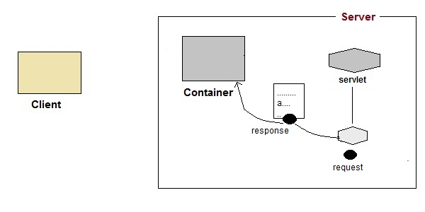
Then the Servlet uses response object to write the response back to the client.

Slide 31
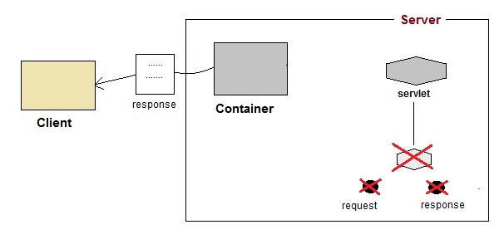
After the service() method is completed the thread dies. And the request and response objects are ready for garbage collection.

Slide 32
web.xml
It is also called as Deployment Descriptor file or configuration file for servlet.
For a Java servlet to be accessible from a browser, you must tell the servlet container what servlets to deploy, and what URL's to map the servlets to. This is done in the web.xml file of your Java web application.
First you configure the servlet. This is done using the <servlet> element. Here you give the servlet a name, and writes the class name of the servlet.
Second, you map the servlet to a URL or URL pattern. This is done in the <servlet-mapping> element.

Slide 33
<web-app>
<servlet>
<servlet-name>controlServlet</servlet-name>
<servlet-class>com.ControlServlet</servlet-class>
</servlet>
<servlet-mapping> // gives a url pattern to your servlet
<servlet-name>controlServlet</servlet-name>
<url-pattern>/home</url-pattern>
</servlet-mapping>
</web-app>

Slide 34
WEB-INF. This directory, which is contained within the Document Root, is invisible from the web container. It contains all resources needed to run the application, from Java classes, to JAR files and libraries, to other supporting files that the developer does not want a web user to access.
Manifest.mf : The manifest is a special file that can contain information about the files packaged in a JAR file. When you create a JAR file, a default manifest is created automatically
The META-INF folder is the home for the MANIFEST. MF file. This file contains meta data about the contents of the JAR.

Slide 35
How to Create Servlet
There are three different ways to create a servlet.
1) By implementing Servlet interface
2) By extending GenericServlet class
3) By extending HttpServlet class

Slide 36
ServletConfig Interface
An object of ServletConfig is created by the web container for each servlet. This object can be used to get configuration information from web.xml file.
If the configuration information is modified from the web.xml file, we don't need to change the servlet.
Advantage of ServletConfig
The core advantage of ServletConfig is that you don't need to edit the servlet file if information is modified from the web.xml file.
So it is easier to manage the web application if any specific content is modified from time to time.

Slide 37
ServletConfig
<web-app>
<servlet>
......
<init-param>
<param-name>parametername</param-name>
<param-value>parametervalue</param-value>
</init-param>
......
</servlet>
</web-app>

Slide 38
ServletContext Interface
An object of ServletContext is created by the web container at time of deploying the project. This object can be used to get configuration information from web.xml file. There is only one ServletContext object per web application.
Advantage of ServletContext
Easy to maintain if any information is shared to all the servlet, it is better to make it available for all the servlet. We provide this information from the web.xml file using the <context-param> element, so if the information is changed, we don't need to modify the servlet.

Slide 39
ServletContext
<web-app>
......
<context-param>
<param-name>parametername</param-name>
<param-value>parametervalue</param-value>
</context-param>
......
</web-app>

Slide 40
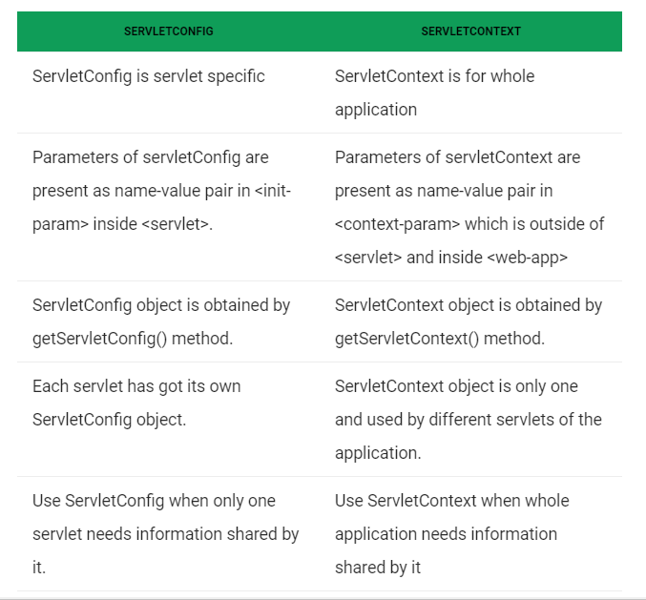

Slide 41
MVC Architecture

Slide 42
There is a lot of software design pattern used for developing any application. During early days of application development, the approach of designing the User Interface, building the business logic as well as coding the logic part for the application was programmed and prepared in a single file which usually created lack of maintenance, make testing of application uneasy as well as reduce the scalability of any application. To overcome this, a model came into existence and gradually became popular.

Slide 43
MVC Architecture
The Model-View-Controller (MVC) architecture is an architectural pattern(design pattern) that separates an application into three main logical components Model, View, and Controller.
Model: It includes all the data and its related logic
View: Present data to the user or handles user interaction
Controller: An interface between Model and View components
Let's see each other this component in detail.

Slide 44
View
A View is that part of the application that represents the presentation of data.
Views are created by the data collected from the model data. A view requests the model(or the controller) to give information so that it resents the output presentation to the user.
The view also represents the data from chats, diagrams, and table. For example, any customer view will include all the UI components like text boxes, drop downs, etc.

Slide 45
Controller
The Controller is that part of the application that handles the user interaction.
A Controller send's commands to the model to update its state(E.g., Saving a specific data). The controller also sends commands to its associated view to change the view's presentation (For example Display particular or all data).

Slide 46
Model
The model component stores data and its related logic. It represents data that is being transferred between controller components or any other related business logic.
The DTO/DAO would be your model in the MVC pattern.

Slide 47
DAO and DTO
DTO is an abbreviation for Data Transfer Object, so it is used to transfer the data between classes and modules of your application.
DTO should only contain private fields for your data, getters, setters, and constructors.
DTO is not recommended to add business logic methods to such classes, but it is OK to add some util methods.
DAO is an abbreviation for Data Access Object, so it should encapsulate the logic for retrieving, saving and updating data in your data storage (a database, a file-system, whatever).

Slide 48
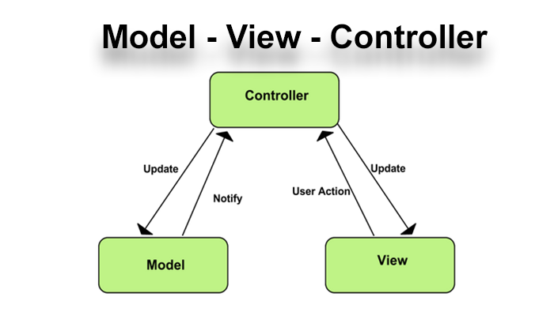

Slide 49
Advantage of MVC over (3-Tier)N-Tier Architecture
N-tier(or 3-Tier Architecture) : This type of architecture pattern never communicates directly with the data layer.
N-tier architecture usually has each layer separated by the network. I.E. the presentation layer is on some web servers, then that talks to backend app servers over the network for business logic, then that talks to a database server, again over the network, and maybe the app server also calls out to some remote services (say Authorize.net for payment processing).

Slide 50
Mvc : All layers communicate directly using triangle topology.
The view and controller may reside on the webserver or application server, and remotely call database servers to retrieve data.

Slide 51
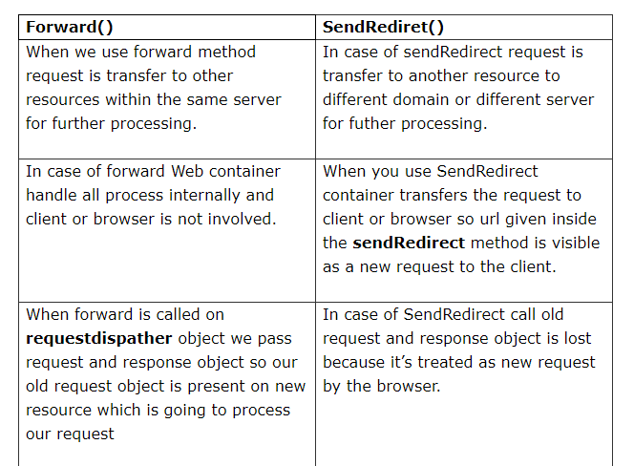
Difference between forward() and sendRedirect()

Slide 52
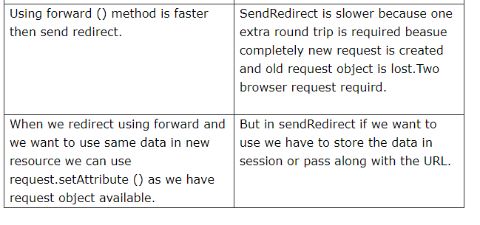
Difference between forward() and sendRedirect()

Slide 53
Managing Session in Servlets
We all know that HTTP is a stateless protocol. All requests and responses are independent. But sometimes you need to keep track of client's activity across multiple requests.
For eg. When a User logs into your website, not matter on which web page he visits after logging in, his credentials will be with the server, until he logs out. So this is managed by creating a session.

Slide 54
Session Management
Session Management is a mechanism used by the Web container to store session information for a particular user. There are four different techniques used by Servlet application for session management. They are as follows:
Cookies
Hidden form field
URL Rewriting
HttpSession
Session is used to store everything that we can get from the client from all the requests the client makes.

Slide 55
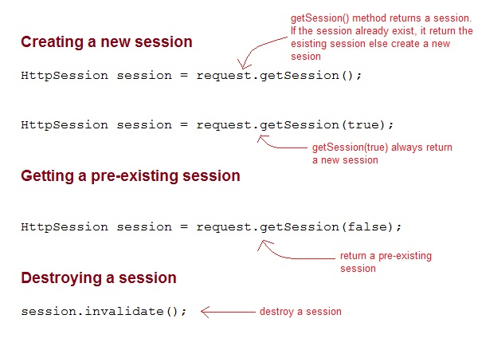
What is HttpSession?
HttpSession object is used to store entire session with a specific client. We can store, retrieve and remove attribute from HttpSession object. Any servlet can have access to HttpSession object through the getSession() method of the HttpServletRequest object.

Slide 56
What is Cookie ?
Cookies are small pieces of information that are sent in response from the web server to the client. Cookies are the simplest technique used for storing client state.
Cookies are stored on client's computer. They have a lifespan and are destroyed by the client browser at the end of that lifespan.
Using Cookies for storing client state has one shortcoming though, if the client has turned of COokie saving settings in his browser then, client state can never be saved because the browser will not allow the application to store cookies.

Slide 57
Types of Cookie
There are 2 types of cookies in servlets.
Non-persistent cookie
Persistent cookie
1 . Non-persistent cookie(SessionCookies) : It is valid for single session only. It is removed each time when user closes the browser. (Banking sites)
2 . Persistent cookie : It is valid for multiple session . It is not removed each time when user closes the browser. It is removed only if user logout or signout.(Gmail)

Slide 58
How to set Cookie ?
Cookies are created using Cookie class present in Servlet API.
Cookies are added to response object using the addCookie() method.
This method sends cookie information over the HTTP response stream.
getCookies() method is used to access the cookies that are added to response object.

Slide 59
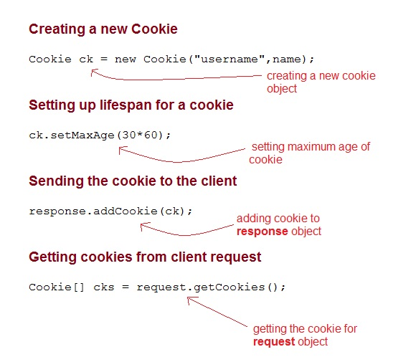

Slide 60
Introduction to Filter
Filters are components that you can use and configure to perform some filtering tasks.
Filter is used for pre-processing of requests and post-processing of responses.
You can have any number of filters for pre-processing of a request and post-processing of a response.
Filters are configured in the deployment descriptor of a web application.

Slide 61
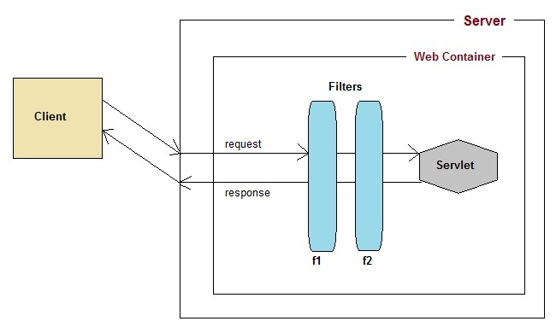

Slide 62
More about Filter
Filter is part of Servlet API. Filter interface is found in the javax.servlet package.
For creating a filter, we must implement Filter interface. Filter interface gives the following life cycle methods for a filter:
void init(FilterConfig filterConfig): invoked by the web container to indicate to a filter that it is being placed into service.
void doFilter(ServletRequest request, ServletResponse response, FilterChain chain) : invoked by the container each time a request/response pair is passed through the chain due to a client request for a resource at the end of the chain.
void destroy(): invoked by the web container to indicate to a filter that it is being taken out of service.

Slide 63
What is FilterChain Interface?
FilterChain object is used to invoke the next filter in the chain, or if the calling filter is the last filter in the chain then the resource at the end of the chain invoked. The resources at the end of Filter chain can either be a target Servlet(in case of request flow) or the Client(in case of response flow) as described in the diagram above.

Slide 64
